Slide 1


Evaluating Named Data Networking for
ECRMT Network: A Simulation-Based
Feasibility Study
Ministry of National Defense
École Militaire Polytechnique
Major : Computer engineering
Specialization : Networks and distributed systems
Directed by :
E.O.C. BOUACHA Seif Eddine E.O.C. CHABANE Bedreddine
Supervisors :
Cpt BOUTMEDJET Yassine
Cpt FERID Djamel Eddine
Academic Year : 2024-2025
Notes:
Good morning, esteemed members of the jury. My name is [Bouacha seif eddine], and I am here with my colleague [chabane bedreddine]. Together, we are pleased to present our work on the topic:
Evaluating Named Data Networking for ECRMT Network: A Simulation-Based Feasibility Study. Before we delve into the details of our presentation, let me first outline its structure.
We will start with an Introduction to set the stage for our work.
Next, we will explore Network Concepts and Challenges, covering three key areas:
Hierarchical Network Design,
Key Challenges of TCP/IP, and
Named Data Networking (NDN).
Following that, we will move to the Design and Proposal of the Network Topology, which includes:
Implementation of the Proposed Topology Using both TCP/IP, and NDN.
Then, we will present our Simulation Results and Evaluation, focusing on:
Metrics,
Simulation Results, and
Evaluation of the findings.
Finally, we will conclude with a summary of our work .

Slide 2

Content
?
Introduction
Network Concepts and Challenges
Hierarchical Network Design
key challenges of TCP/IP
Named Data Networking (NDN)
Implementation of the Proposed Topology Using TCP/IP
Implementation of the Proposed Topology Using ndnSIM
Design and Proposal of The Network Topology
Simulation Results and Evaluation
Metrics
Simulation results
Evaluation
Conclusion and perspectives
Notes:
Good morning, esteemed members of the jury. My name is [Bouacha seif eddine], and I am here with my colleague [chabane bedreddine]. Together, we are pleased to present our work on the topic:
Evaluating Named Data Networking for ECRMT Network: A Simulation-Based Feasibility Study. Before we delve into the details of our presentation, let me first outline its structure.
We will start with an Introduction to set the stage for our work.
Next, we will explore Network Concepts and Challenges, covering three key areas:
Hierarchical Network Design,
Key Challenges of TCP/IP, and
Named Data Networking (NDN).
Following that, we will move to the Design and Proposal of the Network Topology, which includes:
Implementation of the Proposed Topology Using both TCP/IP, and NDN.
Then, we will present our Simulation Results and Evaluation, focusing on:
Metrics,
Simulation Results, and
Evaluation of the findings.
Finally, we will conclude with a summary of our work .

Slide 3
Introduction
1
Notes:
Our internship at the Central Establishment for the Renovation of Transmission Equipment (ECRMT/1°RM) was focused on evaluating Named Data Networking (NDN) as a modern alternative to the existing TCP/IP-based network architecture.
During our work, we faced a significant challenge—the lack of a documented network topology. To address this, we conducted a thorough walkthrough of the organization’s departments. By carefully examining their structure and operations, we were able to reconstruct the network topology. This enabled us to proceed with a detailed comparison of TCP/IP and NDN.

Slide 4





Introduction
1
TCP/IP
Named Data Networking
Notes:
Our internship at the Central Establishment for the Renovation of Transmission Equipment (ECRMT/1°RM) was focused on evaluating Named Data Networking (NDN) as a modern alternative to the existing TCP/IP-based network architecture.
During our work, we faced a significant challenge—the lack of a documented network topology. To address this, we conducted a thorough walkthrough of the organization’s departments. By carefully examining their structure and operations, we were able to reconstruct the network topology. This enabled us to proceed with a detailed comparison of TCP/IP and NDN.

Slide 5
Introduction
1
Named Data Networking
TCP/IP
Notes:
Our internship at the Central Establishment for the Renovation of Transmission Equipment (ECRMT/1°RM) focused on evaluating Named Data Networking (NDN) as a modern alternative to the existing TCP/IP-based network architecture. A significant challenge arose due to the absence of a documented network topology, which made it difficult to analyze and model the current system effectively. To address this, we conducted a comprehensive walkthrough of the organization’s departments, systematically examining their structure, operational requirements, and communication patterns. This approach enabled us to reconstruct the network's topology and proceed with a detailed comparison of TCP/IP and NDN to highlight NDN’s potential advantages in improving performance and addressing existing issues.
Modern networks based on the TCP/IP architecture face significant challenges in meeting the demands of today's dynamic and data-driven environments.
This motivates the exploration of Named Data Networking (NDN), a data-centric architecture that shifts focus from where data is located to what data is needed.

Slide 6

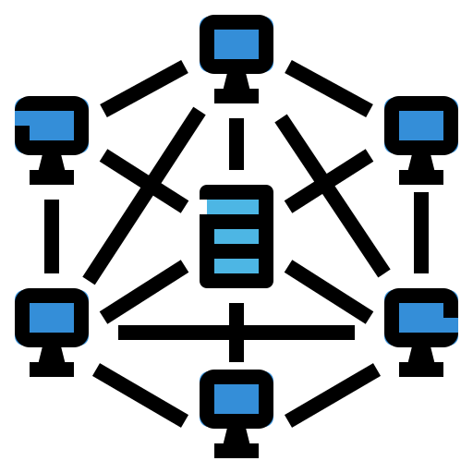
Introduction
1
TCP/IP
Named Data Networking
Notes:
Our internship at the Central Establishment for the Renovation of Transmission Equipment (ECRMT/1°RM) focused on evaluating Named Data Networking (NDN) as a modern alternative to the existing TCP/IP-based network architecture. A significant challenge arose due to the absence of a documented network topology, which made it difficult to analyze and model the current system effectively. To address this, we conducted a comprehensive walkthrough of the organization’s departments, systematically examining their structure, operational requirements, and communication patterns. This approach enabled us to reconstruct the network's topology and proceed with a detailed comparison of TCP/IP and NDN to highlight NDN’s potential advantages in improving performance and addressing existing issues.
Modern networks based on the TCP/IP architecture face significant challenges in meeting the demands of today's dynamic and data-driven environments.
This motivates the exploration of Named Data Networking (NDN), a data-centric architecture that shifts focus from where data is located to what data is needed.

Slide 7

Introduction
1
TCP/IP
Named Data Networking
Notes:
Our internship at the Central Establishment for the Renovation of Transmission Equipment (ECRMT/1°RM) focused on evaluating Named Data Networking (NDN) as a modern alternative to the existing TCP/IP-based network architecture. A significant challenge arose due to the absence of a documented network topology, which made it difficult to analyze and model the current system effectively. To address this, we conducted a comprehensive walkthrough of the organization’s departments, systematically examining their structure, operational requirements, and communication patterns. This approach enabled us to reconstruct the network's topology and proceed with a detailed comparison of TCP/IP and NDN to highlight NDN’s potential advantages in improving performance and addressing existing issues.
Modern networks based on the TCP/IP architecture face significant challenges in meeting the demands of today's dynamic and data-driven environments.
This motivates the exploration of Named Data Networking (NDN), a data-centric architecture that shifts focus from where data is located to what data is needed.

Slide 8
Introduction
1
TCP/IP
Named Data Networking
Notes:
Our internship at the Central Establishment for the Renovation of Transmission Equipment (ECRMT/1°RM) focused on evaluating Named Data Networking (NDN) as a modern alternative to the existing TCP/IP-based network architecture. A significant challenge arose due to the absence of a documented network topology, which made it difficult to analyze and model the current system effectively. To address this, we conducted a comprehensive walkthrough of the organization’s departments, systematically examining their structure, operational requirements, and communication patterns. This approach enabled us to reconstruct the network's topology and proceed with a detailed comparison of TCP/IP and NDN to highlight NDN’s potential advantages in improving performance and addressing existing issues.
Modern networks based on the TCP/IP architecture face significant challenges in meeting the demands of today's dynamic and data-driven environments.
This motivates the exploration of Named Data Networking (NDN), a data-centric architecture that shifts focus from where data is located to what data is needed.

Slide 9
Network Concepts and Challenges
2
Hierarchical Network Design
Key challanges in TCP/IP
Named Data Networking (NDN)
Notes:
In this part, we will explore, as mentioned before, the hierarchical network design, citing the key challenges of TCP/IP. These challenges will pave the way to understand NDN.

Slide 10
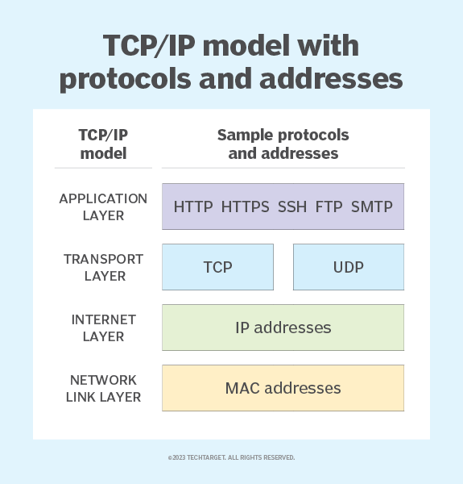
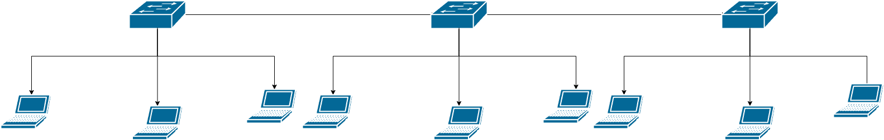
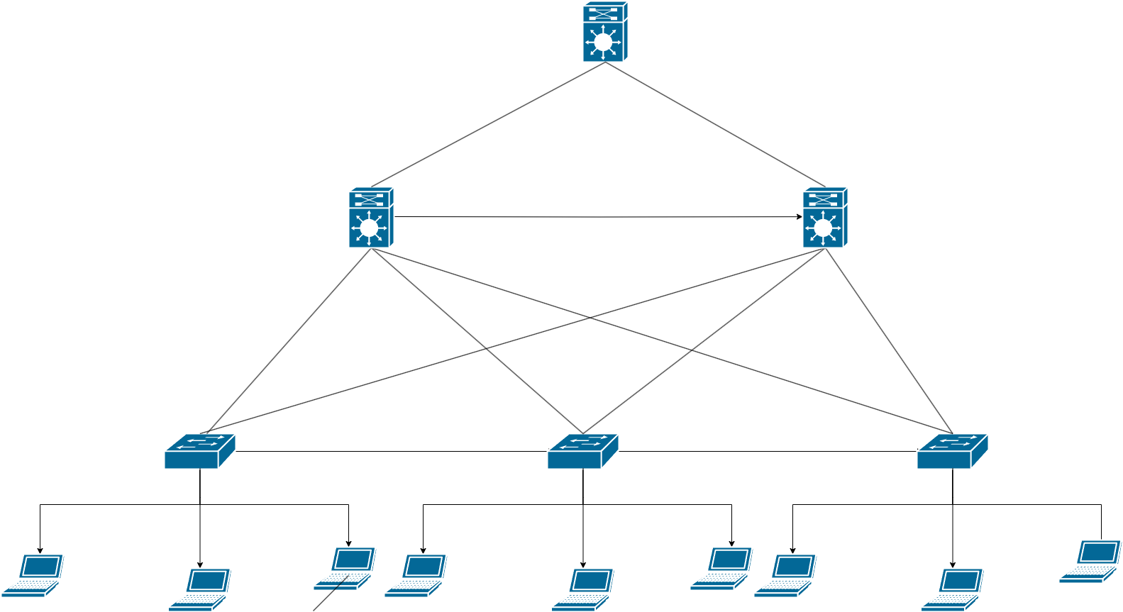
Network Concepts and Challenges Hierarchical Network Design
2
Early networks were deployed in a flat topology, hubs and switches were added as more devices needed to be connected.
A flat network design provided little opportunity to control broadcasts or to filter undesirable traffic.
This layer is responsible for establishing the connection between the sender and the receiver device.
This layer is responsible for maintaining the task of sending and receiving data in raw bits
Deals with addressing and routing data packets to ensure they reach the correct destination across networks.
Notes:
tronsport layer :and also performs the task of dividing the data from the application layer into packets, which are then used to create sequences.

Slide 11
Network Concepts and Challenges Hierarchical Network Design
2
Early networks were deployed in a flat topology, hubs and switches were added as more devices needed to be connected.
A flat network design provided little opportunity to control broadcasts or to filter undesirable traffic.
Notes:
This flat network design would cause delays as the network grows because all devices share the same broadcast domain.
Additionally, it would be challenging for administrators to control or limit broadcast traffic and filter undesired traffic effectively, as there is no structured segmentation to manage these issues.

Slide 12

Network Concepts and Challenges Hierarchical Network Design
Early networks were deployed in a flat topology, hubs and switches were added as more devices needed to be connected.
A flat network design provided little opportunity to control broadcasts or to filter undesirable traffic.
2
Location-Based Communication
Notes:
A better network design approach was needed. For this reason, many modern networks now utilize a hierarchical design. A hierarchical network design involves dividing the network into discrete layers . Each layer, or tier, in the hierarchy provides specific functions that define its role within the
overall network.

Slide 13
Network Concepts and Challenges key challenges of TCP/IP
Early networks were deployed in a flat topology, hubs and switches were added as more devices needed to be connected.
A flat network design provided little opportunity to control broadcasts or to filter undesirable traffic.
2
Location-Based Communication
Location-Based Communication
Notes:
1. Location-Based Communication
TCP/IP: Focuses on "where" the data resides, using IP addresses to identify hosts. This leads to inefficiencies when the same content is requested multiple times from distant locations.
2. Scalability
TCP/IP: The increasing number of devices requires larger IP address spaces (e.g., IPv6) and complex routing tables, making scalability a challenge. 3. Security
TCP/IP: Security in TCP/ip protects communication channels but not the data itself. 6. Mobility Support
TCP/IP: Mobility requires complex mechanisms like Mobile IP to maintain connectivity when devices change locations.

Slide 14
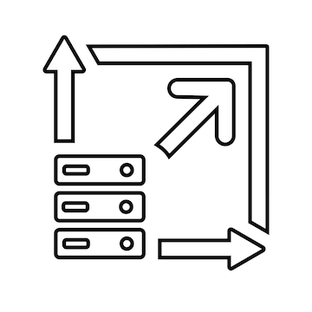
Network Concepts and Challenges key challenges of TCP/IP
Early networks were deployed in a flat topology, hubs and switches were added as more devices needed to be connected.
A flat network design provided little opportunity to control broadcasts or to filter undesirable traffic.
2
Location-Based Communication
Scalability
Notes:
1. Location-Based Communication
TCP/IP: Focuses on "where" the data resides, using IP addresses to identify hosts. This leads to inefficiencies when the same content is requested multiple times from distant locations.
2. Scalability
TCP/IP: The increasing number of devices requires larger IP address spaces (e.g., IPv6) and complex routing tables, making scalability a challenge. 3. Security
TCP/IP: Security in TCP/ip protects communication channels but not the data itself. 6. Mobility Support
TCP/IP: Mobility requires complex mechanisms like Mobile IP to maintain connectivity when devices change locations.

Slide 15

Network Concepts and Challenges key challenges of TCP/IP
Early networks were deployed in a flat topology, hubs and switches were added as more devices needed to be connected.
A flat network design provided little opportunity to control broadcasts or to filter undesirable traffic.
2
Location-Based Communication
Scalability
Security
Notes:
1. Location-Based Communication
TCP/IP: Focuses on "where" the data resides, using IP addresses to identify hosts. This leads to inefficiencies when the same content is requested multiple times from distant locations.
2. Scalability
TCP/IP: The increasing number of devices requires larger IP address spaces (e.g., IPv6) and complex routing tables, making scalability a challenge. 3. Security
TCP/IP: Security in TCP/ip protects communication channels but not the data itself. 6. Mobility Support
TCP/IP: Mobility requires complex mechanisms like Mobile IP to maintain connectivity when devices change locations.

Slide 16

Network Concepts and Challenges key challenges of TCP/IP
Early networks were deployed in a flat topology, hubs and switches were added as more devices needed to be connected.
A flat network design provided little opportunity to control broadcasts or to filter undesirable traffic.
2
Location-Based Communication
Scalability
Security
Mobility
Notes:
1. Location-Based Communication
TCP/IP: Focuses on "where" the data resides, using IP addresses to identify hosts. This leads to inefficiencies when the same content is requested multiple times from distant locations.
2. Scalability
TCP/IP: The increasing number of devices requires larger IP address spaces (e.g., IPv6) and complex routing tables, making scalability a challenge. 3. Security
TCP/IP: Security in TCP/ip protects communication channels but not the data itself. 6. Mobility Support
TCP/IP: Mobility requires complex mechanisms like Mobile IP to maintain connectivity when devices change locations.

Slide 17
Network Concepts and Challenges key challenges of TCP/IP
Early networks were deployed in a flat topology, hubs and switches were added as more devices needed to be connected.
A flat network design provided little opportunity to control broadcasts or to filter undesirable traffic.
2
Location-Based Communication
Scalability
Security
Mobility
Notes:
1. Location-Based Communication
TCP/IP: Focuses on "where" the data resides, using IP addresses to identify hosts. This leads to inefficiencies when the same content is requested multiple times from distant locations.
2. Scalability
TCP/IP: The increasing number of devices requires larger IP address spaces (e.g., IPv6) and complex routing tables, making scalability a challenge. 3. Security
TCP/IP: Security in TCP/ip protects communication channels but not the data itself. 6. Mobility Support
TCP/IP: Mobility requires complex mechanisms like Mobile IP to maintain connectivity when devices change locations.

Slide 18



Network Concepts and Challenges Named Data Networking (NDN)
2
Data name
IP address
NDN
Notes:
SWORD est un Framework développé par deux binômes au sein de notre école, conçu pour lutter contre la propagation des fausses nouvelles. Il est composé de cinq modules principaux :
S (Social Media Harvester) : Ce module est responsable de la collecte de données à partir de Twitter .
W (Web Data Analyzer) : Il s’occupe du traitement, de l’analyse et de l’enrichissement des données collectées et la visualisation de ces analyses.
O (Online Rumors Fighter) : Réalisé par GUERFI et BOULMA, ce module vise à minimiser l’influence des rumeurs.
R (Rumors and Fake News Detector) : Réalisé par DOUMAZ, ce module est dédié à la détection et vérification des rumeurs et des fausses nouvelles.
D (Data Defender) : Ce module assure un stockage sécurisé et fiable des données collectées.
Voir la remarque de hosni sur ce slide.

Slide 19




Network Concepts and Challenges Named Data Networking (NDN)
2
I want the video /Video/NDN.mp4
Router NDN
Consumer 1
Producer
I want the video /Video/NDN.mp4
Router NDN
Router NDN
Consumer 2
DATA caching
DATA caching
Communication principle
Notes:
Où le principe de communication est le suivant :
[CLICK] si un consommateur veut une donnée nommée , la requete va se propagée dans le réseau jusqu’a atteindre son producteur. Avec la proprieté de «In-Network caching» dans le routeur NDN,
[CLICK] Si un autre consommateur demande la meme donnée , Il va etre satisfié directment a partir du cache de routeur NDN. Et le reseau ne va pas etre surchargé.

Slide 20
Network Concepts and Challenges Named Data Networking (NDN)
2
Paquet types:
Interest packet
Content name /Algeria/MDN/EMP/Informatique/Stage/rapport.pdf
Selector
Nonce
Data packet
Content name /Algeria/MDN/EMP/Informatique/Stage/rapport.pdf
Signature
Signed info
Data
Notes:
Dans NDN, il existe deux types de paquets :
les paquets d'intérêt qui transportent la demande du contenu.
Et les paquets de données qui représentent la réponse a cette demande.

Slide 21
Network Concepts and Challenges Named Data Networking (NDN)
2
NDN Router Structure:
NDN Router
Notes:
SWORD est un Framework développé par deux binômes au sein de notre école, conçu pour lutter contre la propagation des fausses nouvelles. Il est composé de cinq modules principaux :
S (Social Media Harvester) : Ce module est responsable de la collecte de données à partir de Twitter .
W (Web Data Analyzer) : Il s’occupe du traitement, de l’analyse et de l’enrichissement des données collectées et la visualisation de ces analyses.
O (Online Rumors Fighter) : Réalisé par GUERFI et BOULMA, ce module vise à minimiser l’influence des rumeurs.
R (Rumors and Fake News Detector) : Réalisé par DOUMAZ, ce module est dédié à la détection et vérification des rumeurs et des fausses nouvelles.
D (Data Defender) : Ce module assure un stockage sécurisé et fiable des données collectées.
Voir la remarque de hosni sur ce slide.

Slide 22
Network Concepts and Challenges Named Data Networking (NDN)
2
NDN Router Structure:
Content Store
NDN Router
Notes:
SWORD est un Framework développé par deux binômes au sein de notre école, conçu pour lutter contre la propagation des fausses nouvelles. Il est composé de cinq modules principaux :
S (Social Media Harvester) : Ce module est responsable de la collecte de données à partir de Twitter .
W (Web Data Analyzer) : Il s’occupe du traitement, de l’analyse et de l’enrichissement des données collectées et la visualisation de ces analyses.
O (Online Rumors Fighter) : Réalisé par GUERFI et BOULMA, ce module vise à minimiser l’influence des rumeurs.
R (Rumors and Fake News Detector) : Réalisé par DOUMAZ, ce module est dédié à la détection et vérification des rumeurs et des fausses nouvelles.
D (Data Defender) : Ce module assure un stockage sécurisé et fiable des données collectées.
Voir la remarque de hosni sur ce slide.

Slide 23
Foundations of TCP/IP and NDN Networking Technologie Named Data Networking (NDN)
2
NDN Router Structure:
Pending Interest Table
NDN Router
Notes:
SWORD est un Framework développé par deux binômes au sein de notre école, conçu pour lutter contre la propagation des fausses nouvelles. Il est composé de cinq modules principaux :
S (Social Media Harvester) : Ce module est responsable de la collecte de données à partir de Twitter .
W (Web Data Analyzer) : Il s’occupe du traitement, de l’analyse et de l’enrichissement des données collectées et la visualisation de ces analyses.
O (Online Rumors Fighter) : Réalisé par GUERFI et BOULMA, ce module vise à minimiser l’influence des rumeurs.
R (Rumors and Fake News Detector) : Réalisé par DOUMAZ, ce module est dédié à la détection et vérification des rumeurs et des fausses nouvelles.
D (Data Defender) : Ce module assure un stockage sécurisé et fiable des données collectées.
Voir la remarque de hosni sur ce slide.

Slide 24
Network Concepts and Challenges Named Data Networking (NDN)
2
NDN Router Structure:
Forwarding Information Base
NDN Router
Notes:
SWORD est un Framework développé par deux binômes au sein de notre école, conçu pour lutter contre la propagation des fausses nouvelles. Il est composé de cinq modules principaux :
S (Social Media Harvester) : Ce module est responsable de la collecte de données à partir de Twitter .
W (Web Data Analyzer) : Il s’occupe du traitement, de l’analyse et de l’enrichissement des données collectées et la visualisation de ces analyses.
O (Online Rumors Fighter) : Réalisé par GUERFI et BOULMA, ce module vise à minimiser l’influence des rumeurs.
R (Rumors and Fake News Detector) : Réalisé par DOUMAZ, ce module est dédié à la détection et vérification des rumeurs et des fausses nouvelles.
D (Data Defender) : Ce module assure un stockage sécurisé et fiable des données collectées.
Voir la remarque de hosni sur ce slide.

Slide 25


Network Concepts and Challenges Named Data Networking (NDN)
2
Forwarding Process:
Data
Arrival
Interest
Entrance
/Video/NDN.mp4
/Video/NDN.mp4
Remove face
Router NDN
Add face
Prefix name | Data
/Video/NDN.mp4 | C:/Video/NDN.mp4
. . . . | . . . .
Prefix name | Data
/Video/NDN.mp4 | __
. . . . | . . . .
Prefix name | Next face
/Video | 0
… | …
Prefix name | Requested face (s)
/Video/NDN.mp4 | 0 ; 1
… | …
Prefix name | Requested face (s)
/Video/NDN.mp4 | 0 ; 1
… | …
Notes:
A l’arrivée d’un paquet Interest, le routeur vérifie si sa reponse existe dans le cache, il lui répond directement, [CLICK] si non ,il ajoute la face d’entrée dans la PIT, puis il achemine le paquet via les faces de sortie de la table FIB.[CLICK] A l’arrivée d’une donnée , les requêtes sont satisfiées, après quelles soient stockées dans le cache.

Slide 26
Design and Proposal of The Network Topology
3
Network design
Implementation of the Proposed Topology Using TCP/IP
Implementation of the Proposed Topology Using ndnSIM
Notes:
. In this section, we will discuss how the network topology was designed and implemented, focusing on both the TCP/IP and NDN approaches.

Slide 27
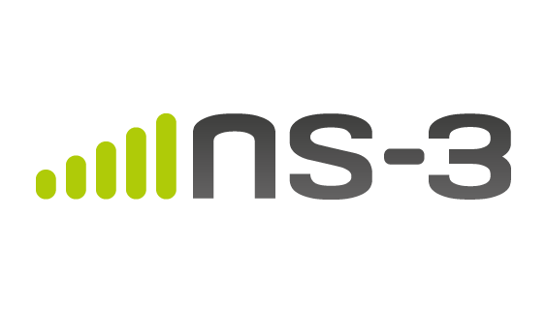



Design and Proposal of The Network
3
ndnSIM
NetAnim
Notes:
To achieve our objectives and implement the network m, we relied on several key tools.
To design the topology, we used Packet Tracer, which allowed us to test and refine our network.
Moving to the simulation phase, ns-3 was the backbone of our implementation. Using ns-3, we built and configured the TCP/IP-based network model.
For Named Data Networking, we turned to ndnSIM, a module built on top of
ns-3, which provided the necessary framework to simulate NDN functionalities such as content caching and interest-data exchanges.
To analyze and validate our results, we used Wireshark to inspect packet flows and NetAnim for a visual representation of network operations.

Slide 28
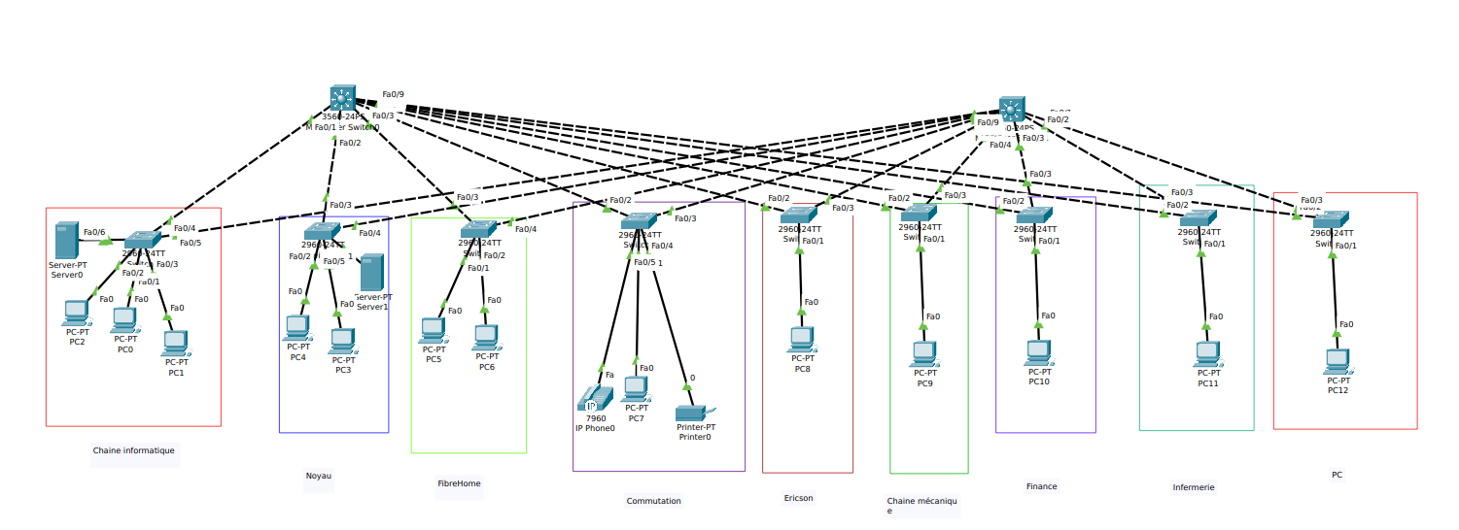
Design and Proposal of The Network
3
NetAnim
ndnSIM
Notes:
To achieve our objectives and implement the network models for comparison, we relied on several key tools, each chosen for its specific strengths and capabilities. Let me walk you through them.

Slide 29
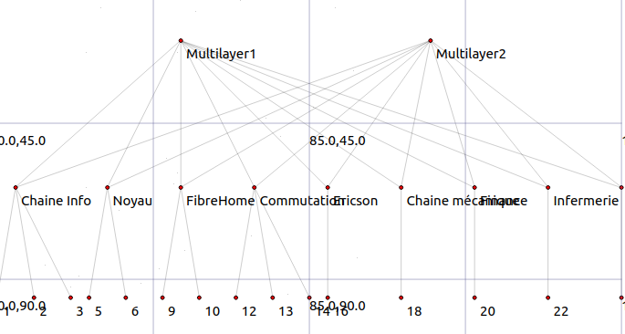
Design and Proposal of The Network Network design
3
29/38
To replicate the TCP/IP network topology initially designed in Packet Tracer, the process involved carefully translating the logical design into actionable steps within the ns-3 environment. Below, we explain the main steps to achieve this implementation.
Notes:
For our network topology, we chose the hierarchical design because it adheres to essential principles like hierarchy, modularity, resilience, and flexibility, ensuring a reliable and scalable infrastructure.
Our topology includes 9 departments, each with its own access switch, connected to two distribution switches for redundancy and high availability, preventing single points of failure."

Slide 30
Design and Proposal of The Network Implementation of the Proposed Topology Using TCP/IP
3
Create Nodes
To replicate the TCP/IP network topology initially designed in Packet Tracer, the process involved carefully translating the logical design into actionable steps within the ns-3 environment. Below, we explain the main steps to achieve this implementation.
30/38
Notes:
For our network topology, we chose the hierarchical design because it adheres to essential principles like hierarchy, modularity, resilience, and flexibility, ensuring a reliable and scalable infrastructure.
Our topology includes 9 departments, each with its own access switch, connected to two distribution switches for redundancy and high availability, preventing single points of failure."

Slide 31
Design and Proposal of The Network Implementation of the Proposed Topology Using TCP/IP
3
Create Nodes
To replicate the TCP/IP network topology initially designed in Packet Tracer, the process involved carefully translating the logical design into actionable steps within the ns-3 environment. Below, we explain the main steps to achieve this implementation.
Set Up Peer-to-Peer Links
31/53
Notes:
In ns-3, a node represents a network device or system , capable of running applications and network protocols.

Slide 32
Design and Proposal of The Network Implementation of the Proposed Topology Using TCP/IP
3
Create Nodes
To replicate the TCP/IP network topology initially designed in Packet Tracer, the process involved carefully translating the logical design into actionable steps within the ns-3 environment. Below, we explain the main steps to achieve this implementation.
Set Up Peer-to-Peer Links
Install Internet Stack
32/53
Notes:
Set Up Peer-to-Peer Links : In our topology, we customized the links by specifying distinct parameters, including delay and data rate, for the connections. The delay and data rate values between the access switches and end devices were set lower than those between the access switches and the multilayer switches,

Slide 33
Design and Proposal of The Network Implementation of the Proposed Topology Using TCP/IP
3
Create Nodes
To replicate the TCP/IP network topology initially designed in Packet Tracer, the process involved carefully translating the logical design into actionable steps within the ns-3 environment. Below, we explain the main steps to achieve this implementation.
Set Up Peer-to-Peer Links
Install Internet Stack
33/53
Notes:
moving to the next step is the installation of the Internet protocol stack on the specified nodes, enabling them to use TCP/IP functionalities.

Slide 34
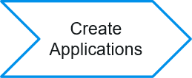
Design and Proposal of The Network Implementation of the Proposed Topology Using TCP/IP
3
To replicate the TCP/IP network topology initially designed in Packet Tracer, the process involved carefully translating the logical design into actionable steps within the ns-3 environment. Below, we explain the main steps to achieve this implementation.
Assign IP Addresses
Configure Tcp Socket
34/53
Install Internet Stack
Notes:
For our network topology, we chose the hierarchical design because it adheres to essential principles like hierarchy, modularity, resilience, and flexibility, ensuring a reliable and scalable infrastructure.
Our topology includes 9 departments, each with its own access switch, connected to two distribution switches for redundancy and high availability, preventing single points of failure."

Slide 35
Design and Proposal of The Network Implementation of the Proposed Topology Using TCP/IP
3
Assign IP Addresses
To replicate the TCP/IP network topology initially designed in Packet Tracer, the process involved carefully translating the logical design into actionable steps within the ns-3 environment. Below, we explain the main steps to achieve this implementation.
Configure Tcp Socket
35/53
Install Internet Stack
Notes:
To enable communication, we developed a custom application for the client and server and installed it on specific nodes. We then configured a TCP socket to allow the client to send and receive messages effectively.

Slide 36
Design and Proposal of The Network Implementation of the Proposed Topology Using TCP/IP
3
Assign IP Addresses
To replicate the TCP/IP network topology initially designed in Packet Tracer, the process involved carefully translating the logical design into actionable steps within the ns-3 environment. Below, we explain the main steps to achieve this implementation.
Configure Tcp Socket
36/53
Install Internet Stack
Run the Simulator
Notes:
For our network topology, we chose the hierarchical design because it adheres to essential principles like hierarchy, modularity, resilience, and flexibility, ensuring a reliable and scalable infrastructure.
Our topology includes 9 departments, each with its own access switch, connected to two distribution switches for redundancy and high availability, preventing single points of failure."

Slide 37
Design and Proposal of The Network Implementation of the Proposed Topology Using TCP/IP
3
Assign IP Addresses
To replicate the TCP/IP network topology initially designed in Packet Tracer, the process involved carefully translating the logical design into actionable steps within the ns-3 environment. Below, we explain the main steps to achieve this implementation.
Run the Simulator
Configure Tcp Socket
37/53

Slide 38
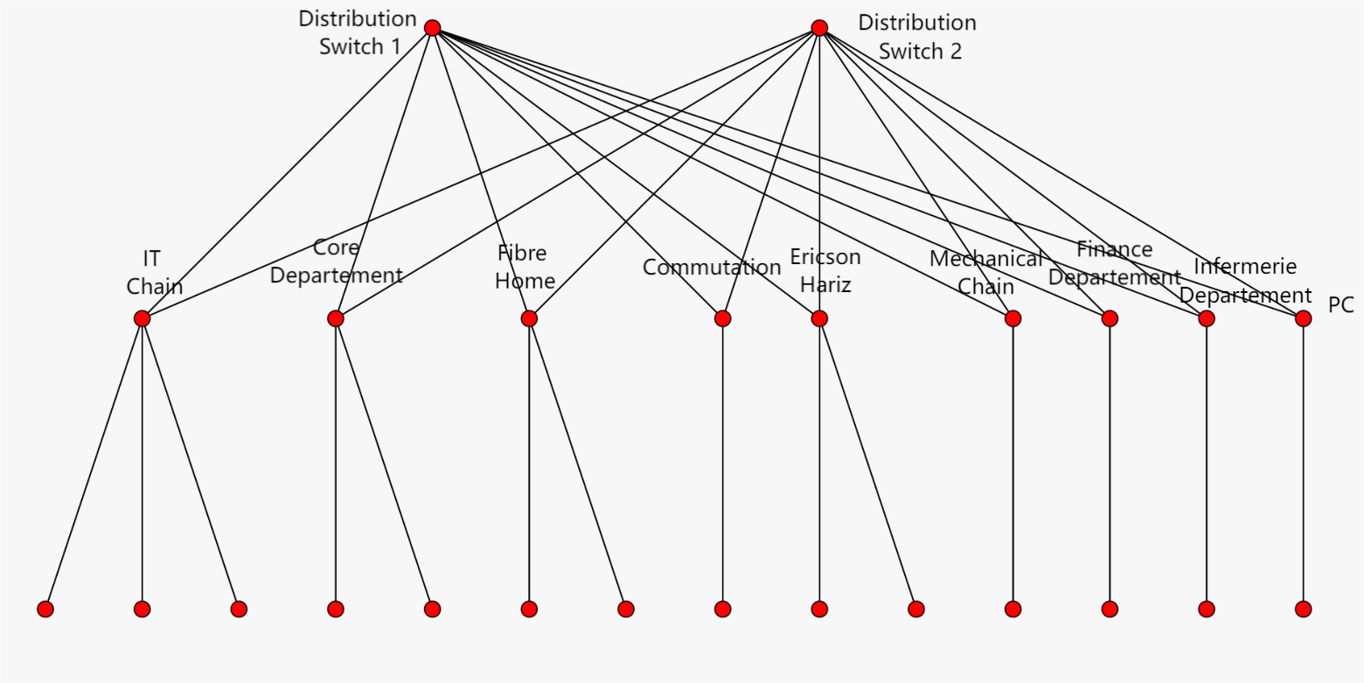
Design and Proposal of The Network Implementation of the Proposed Topology Using ndnSIM
3
38/53
Notes:
Détaillons le module D

Slide 39
Design and Proposal of The Network Implementation of the Proposed Topology Using ndnSIM
3
Topology Initialization
NDN Stack Installation
ForwardigStrategy Setup
29/53
Notes:
Détaillons le module D

Slide 40
Design and Proposal of The Network Implementation of the Proposed Topology Using ndnSIM
3
Routing Interface Initialization
Node Assignment
Consumer Application Installation
40/53
Notes:
Détaillons le module D

Slide 41
Design and Proposal of The Network Implementation of the Proposed Topology Using ndnSIM
3
Producer Application Installation
Route Calculation
Simulation Execution
41/53
Notes:
Détaillons le module D

Slide 42
Simulation Results and Evaluation
4
Metrics
Simulation Results
Evaluation
Notes:
Maintenant. nous allons présenter une vidéo pour mieux illustrer ce que nous avons fait le long de notre travail. Il est à noter que notre système développé est présentée sous forme d’une application web où chaque composante décrite précédemment est gérée à travers les interfaces graphiques qui lui sont dédiées.

Slide 43



Simulation Results and Evaluation Metrics
Average Throughput
Average Delay
Packet Drop Rate
5
The time needed to transfer a packet from source to destination
Defined as failure of packet data transmission to reach the destination
The speed of sending data to the destination
Notes:
Dans cette vidéo, nous allons présenter le formulaire à remplir pour lancer une investigation. Les paramètres nécessaires sont les suivants :
Le nom de l'investigation
Les mots-clés à rechercher
Le nombre maximum de posts à trouver

Slide 44
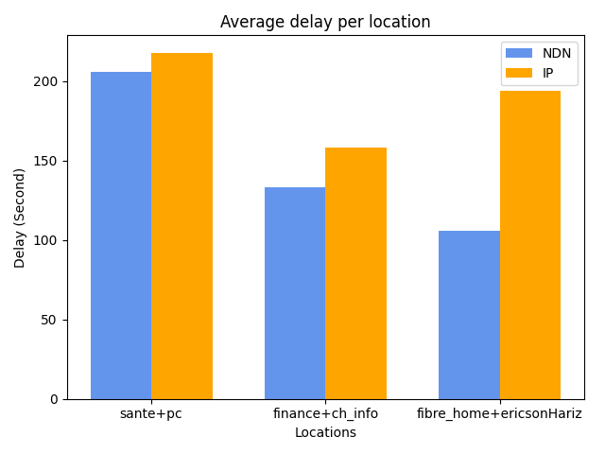
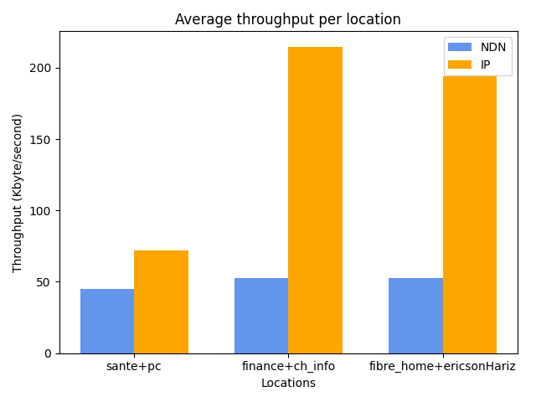
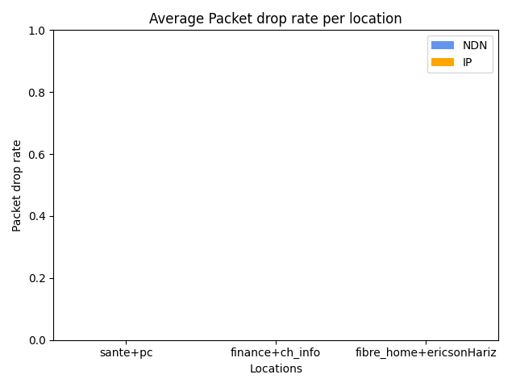
Simulation Results and Evaluation Simulation Results
5
Scenario 1
Notes:
Scenario 1 :
Two consumers and one producer.

Slide 45
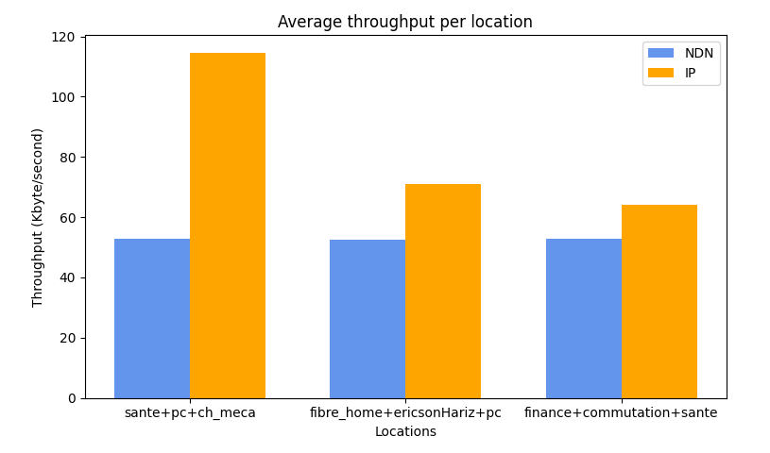
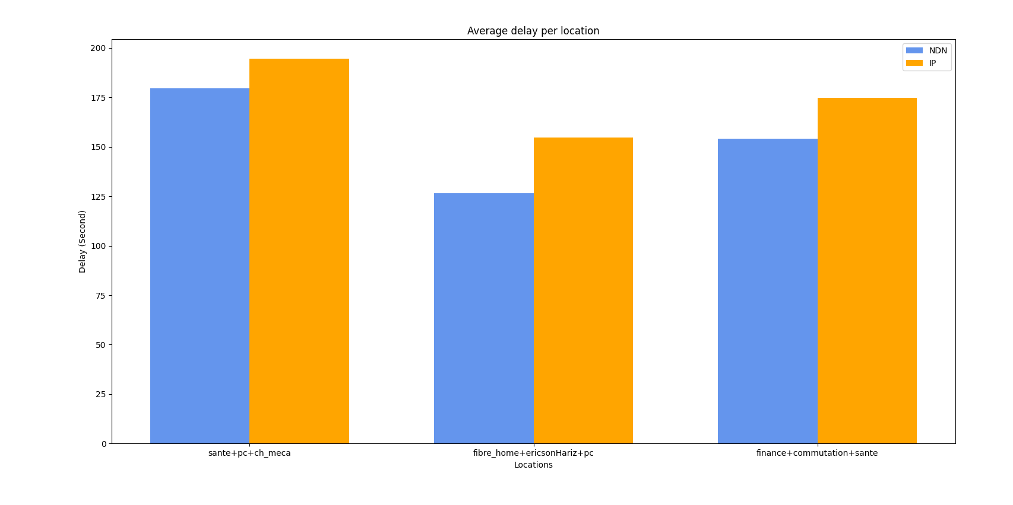
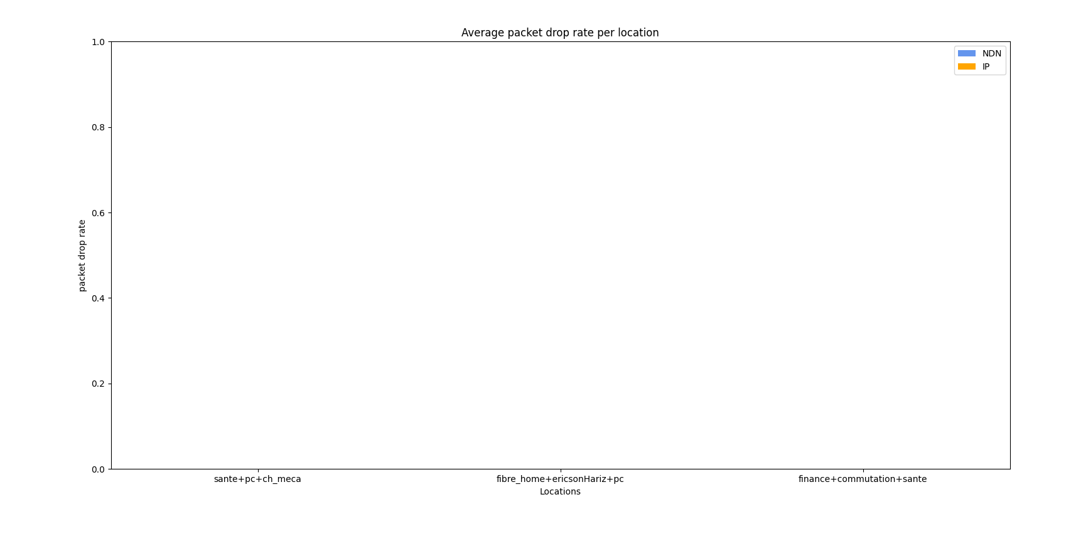
Simulation Results and Evaluation Simulation Results
5
Scenario 2
Notes:
Scenario 2 :
Three consumers and one producer.

Slide 46
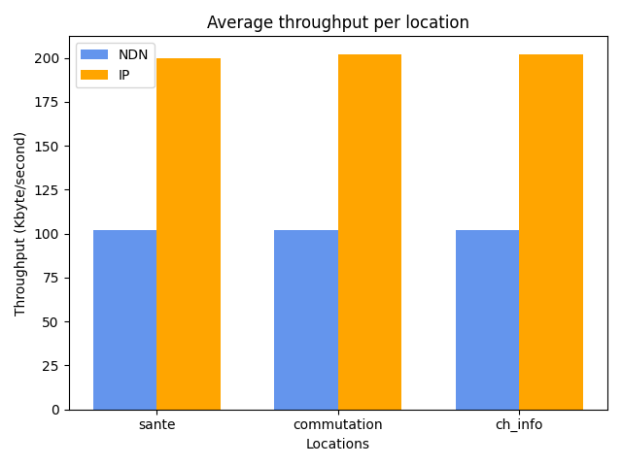
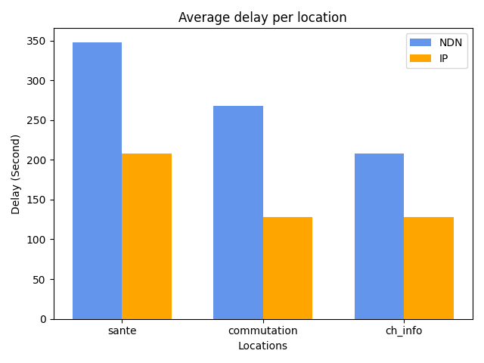
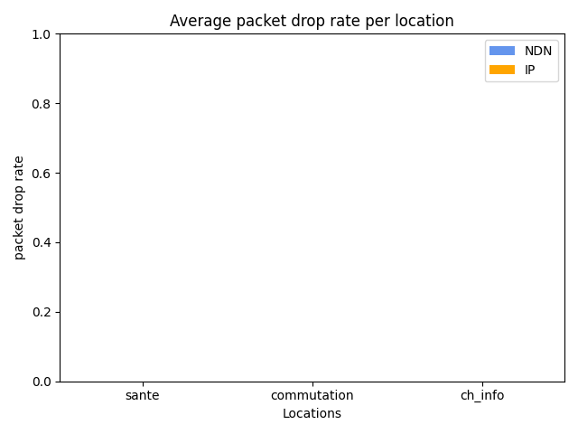
Simulation Results and Evaluation Simulation Results
5
Scenario 3
Notes:
Scenario 3 :
One consumer and two producers.

Slide 47

Simulation Results and Evaluation Evaluation
5
IP-based Networks
NDN Networks
Higher Throughput
Lower Throughput
Throughput
Notes:
Generally exhibit higher throughput because every content request is directly sent to the producer, ensuring consistent data transfer rates. However, repeated requests for the same content create redundant traffic.​
Throughput is typically lower since content caching (content store) reduces the need for repeated transmissions from producers. Cached content is served locally, decreasing overall network traffic.

Slide 48
Simulation Results and Evaluation Evaluation
5
IP-based Networks
NDN Networks
Higher Delay
Lower Delay
Delay
Notes:
Delay is higher as every request must travel to the producer and back, regardless of the content's popularity or location.​
Delay is generally lower due to the availability of cached content in intermediate nodes, allowing consumers to retrieve data from the nearest node rather than the producer.​

Slide 49
Simulation Results and Evaluation Evaluation
5
IP-based Networks
NDN Networks
No packet drop
No packet drop
Packet Drop

Slide 50
Conclusion and perspectives
5
Notes:
nous terminant notre presentation par con et per

Slide 51

Conclusion
5
Feasibility of NDN for ECRMT:
The simulation study demonstrates that Named Data Networking (NDN) is a feasible alternative to the existing TCP/IP-based network for ECRMT, with notable advantages in specific scenarios.
Performance Improvements:
NDN reduces delay and enhances efficiency through its in-network caching mechanism, which allows for quicker data retrieval and reduced dependency on producers.
Traffic Optimization:
By leveraging content stores, NDN minimizes redundant traffic, significantly lowering network congestion and improving overall performance during high-demand scenarios.

Slide 52

Perspectives
5
Potential for Future Implementation:
The study highlights NDN’s suitability for ECRMT’s network, paving the way for further research and potential implementation to improve network scalability, efficiency, and performance.
Recommendation for ECRMT:
It is recommended to conduct pilot deployments of NDN in specific areas of the network to validate its practical benefits and address any operational challenges.
Challenges in NDN Adoption:
While NDN provides clear benefits, its performance is influenced by factors like routing policies, content store size, and interest packet rates, requiring careful tuning for optimal results.

Slide 53
Thank you for your attention

